Slide 1
Azure Immersion Workshop: Infrastructure Migration
Session 7: Windows, SQL & Linux migration
May 2020
Speaker Name

Slide 2
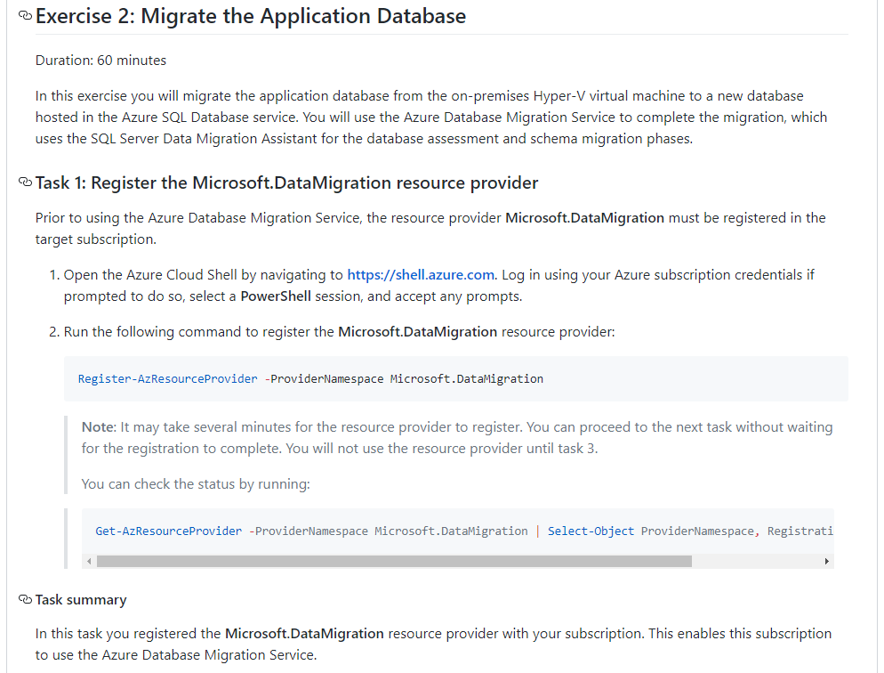
Hands on lab, Windows, SQL & Linux migration
Time Slot: 3:00 - 4:15 PM
Topic: Migrate the SmartHotel Application (Windows Server, SQL Server and Linux Server migration)
ToDo:
In this exercise you will migrate applications that run on Windows Server, SQL Server and Linux from the on-premises Hyper-V virtual machines to new virtual machines and Azure Database Services for SQL Server hosted in Azure.
You will use Azure Migrate to migrate the Windows Server and Linux Servers, and the Azure Database Migration Service (DMS) to complete the migration for the database, which uses the Microsoft Data Migration Assistant (DMA). By end of this session, all components will have been migrated to Azure.
(And remember to clean up resources if you're not using them!)
Flow:
Let the attendees in their groups deploy the CAF basic landing zone blueprint and add components they discussed in the Landing Zone exercise before. Then continues from HOL Exercise 2 Task 5 from the MCW content.
Notes:
open a team for all attendees and add channels for each group of attendees working together (3-5 attendees per channel). Hold live session in each channel during this group-based work and get all attendees together in the general channel afterwards.
it would be easier if the trainer divides the attendees into groups and post the separation in the general channel
open in each channel a team meeting – so you can jump around as trainer
Task 5: Create a DMS migration project
Task 6: Migrate the database schema
Task 7: Migrate the on-premises data
Exercise 3: Migrate the application and web tiers using Azure Migrate: Server Migration
Task 1: Create a Storage Account
Task 2: Create a Virtual Network
Task 3: Register the Hyper-V Host with Azure Migrate Server Migration
Task 4: Enable Replication from Hyper-V to Azure Migrate
Task 5: Configure static internal IP addresses for each VM
Task 6: Server migration
Task 7: Enable Azure Bastion
Task 8: Configure the database connection
Task 9: Configure the public IP address and test the SmartHotel application
Task 10: Post-migration steps
After the hands-on lab
Task 1: Clean up resources

Slide 3
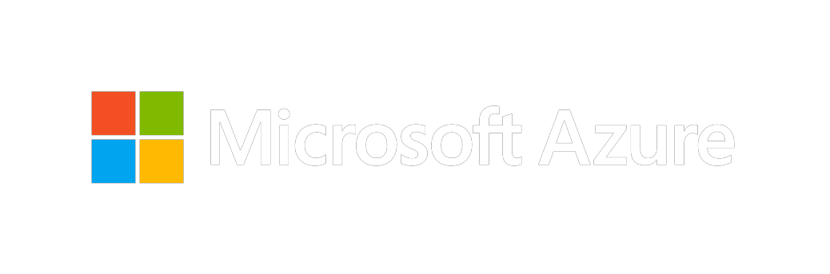
Thank you for joining us.
© 2018 Microsoft Corporation. All rights reserved. Microsoft, Windows, Windows Vista and other product names are or may be registered trademarks and/or trademarks in the U.S. and/or other countries.
The information herein is for informational purposes only and represents the current view of Microsoft Corporation as of the date of this presentation. Because Microsoft must respond to changing market conditions, it should not be interpreted to be a commitment on the part of Microsoft, and Microsoft cannot guarantee the accuracy of any information provided after the date of this presentation. MICROSOFT MAKES NO WARRANTIES, EXPRESS, IMPLIED OR STATUTORY, AS TO THE INFORMATION IN THIS PRESENTATION.

